Slide 1
ESFRI LANDSCAPE ANALYSIS
2024
Gelsomina Pappalardo
National Research Council of Italy
ESFRI Vice-Chair
gelsomina.pappalardo@cnr.it
Conference Research Infrastructures, 4-5 June 2024, Brussels

Slide 2
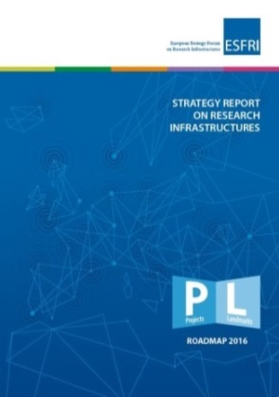
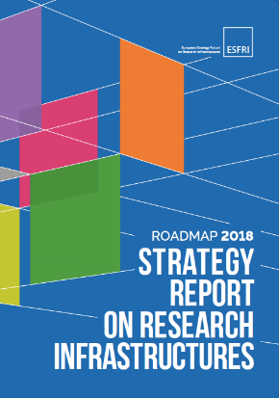
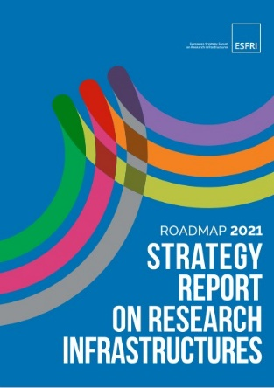
ESFRI Landscape Analysis
Since 2016, ESFRI has introduced the Landscape Analysis in its Roadmaps, providing an overview of the European Research Infrastructure (RI) ecosystem, identifying key RIs and their global positioning.
2016
2018
2021
Conference Research Infrastructures | 4-5 June 2024, Brussels

Slide 3
ESFRI Landscape Analysis 2024
The ESFRI Landscape Analysis 2024 presents three main novelties:
It is the first Landscape Analysis report to be decoupled from the Roadmap, providing the framework and the rationale for the next ESFRI Roadmap;
It includes the first version of the ESFRI RIs Portfolio, developed as an online tool to ensure up-to-date and readily usable information about all ESFRI RIs;
For the first time, the analysis was also based on input directly from key stakeholders.
Conference Research Infrastructures | 4-5 June 2024, Brussels

Slide 4
ESFRI Landscape Analysis 2024
Input received from
RIs (not only ESFRI) /RIs Clusters
Large umbrella organizations (15 published on the ESFRI website)
Input from other stakeholders
ESFRI LA DG + SWGs + external experts for a total of more the 60 people directly involved in the analysis and in preparing the report
+ ESFRI Forum for comments and suggestions
+ RIs and stakeholders
More than 200 people involved in total
Conference Research Infrastructures | 4-5 June 2024, Brussels

Slide 5
ESFRI Landscape Analysis 2024
The ESFRI Landscape Analysis Report 2024 includes two main sections:
Section 1 focuses on each of the six ESFRI Scientific domain (DIGIT, ENE, ENV, H&F, PSE, SSH.
It includes assessments of the current status, services offered, potential impact, trends, gaps and needs identified for each scientific domain as well as cross-domain aspects as identified from the specific domain.
Section 2 offers a broader view across all domains.
It encompasses current status, future trends, challenges, and opportunities of ESFRI RIs considered in their overarching characteristics, thus complementing the cluster-focused Section 1.
Conference Research Infrastructures | 4-5 June 2024, Brussels
Conference Research Infrastructures | 4-5 June 2024, Brussels

Slide 6
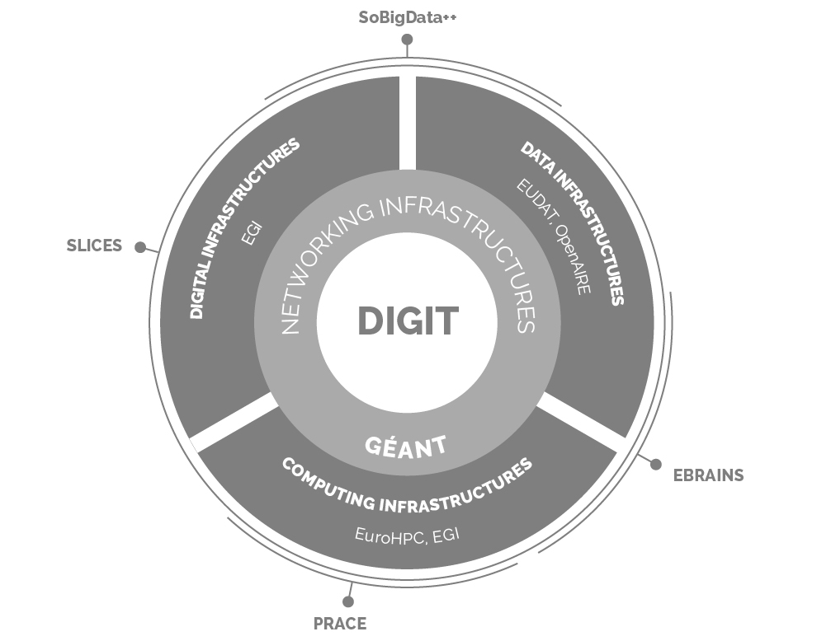
Section 1 DIGIT
Critical areas identified:
Competence development
Synergy and collaboration between EuroHPC and EOSC
Software development and scaling
Sustainability and green transition
Quality and usability of data
1 Landmark (PRACE) and 3 Projects (EBRAINS, SLICES and SoBigData++)
Conference Research Infrastructures | 4-5 June 2024, Brussels

Slide 7
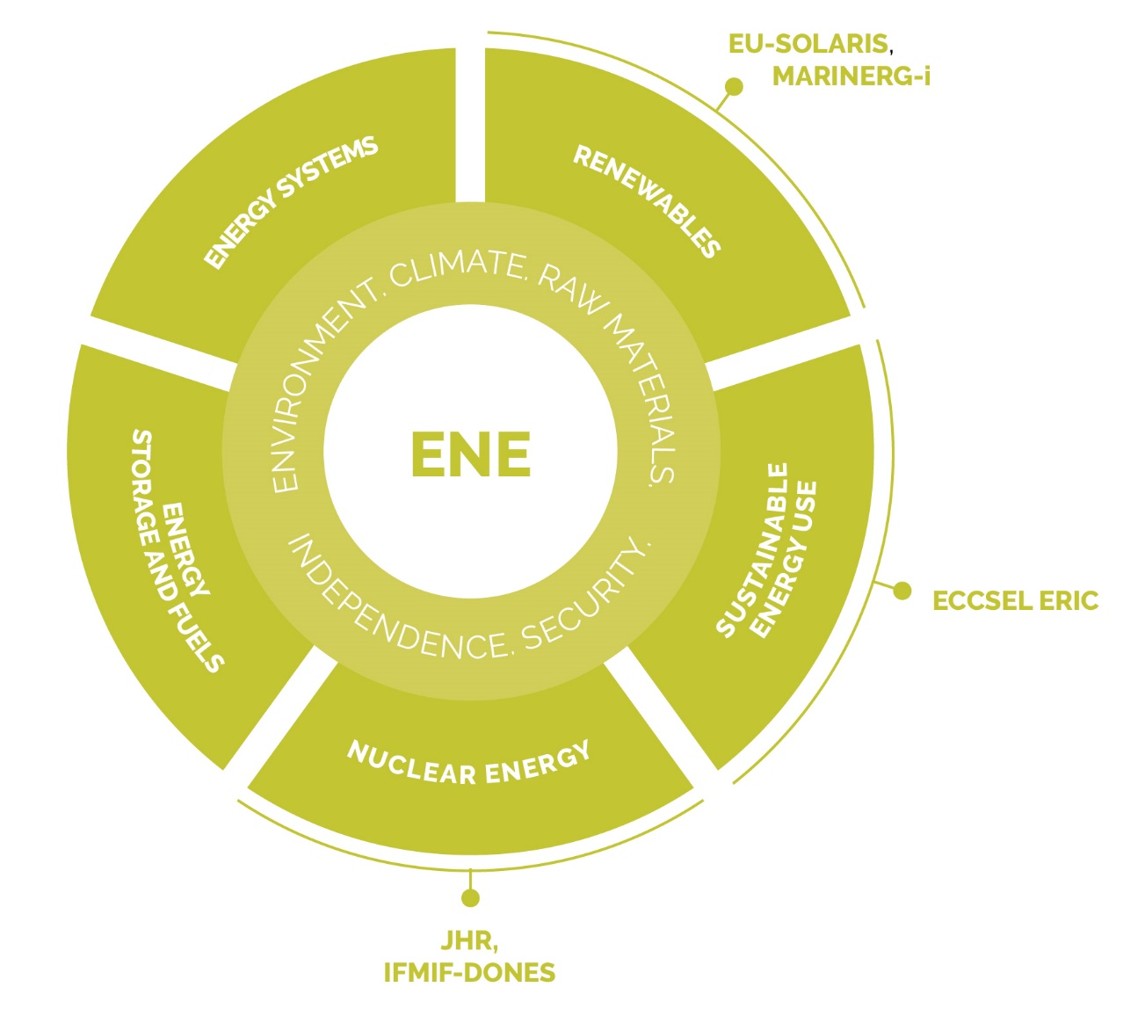
Section 1 ENE
Society constantly seeks the fast development of new, better energy solutions, in terms of efficiency, energy services, sustainability through circularity, security of supply and true (unsubsidised) cost.
Innovative research is often central in producing these.
Relevant areas include energy production (electricity, heat and synfuel), energy transmission, energy storage, and energy use.
3 Landmarks (ECCSEL ERIC, EU-SOLARIS, JHR) and 2 Projects (IFMIF-DONES, MARINERG-I)
Conference Research Infrastructures | 4-5 June 2024, Brussels

Slide 8
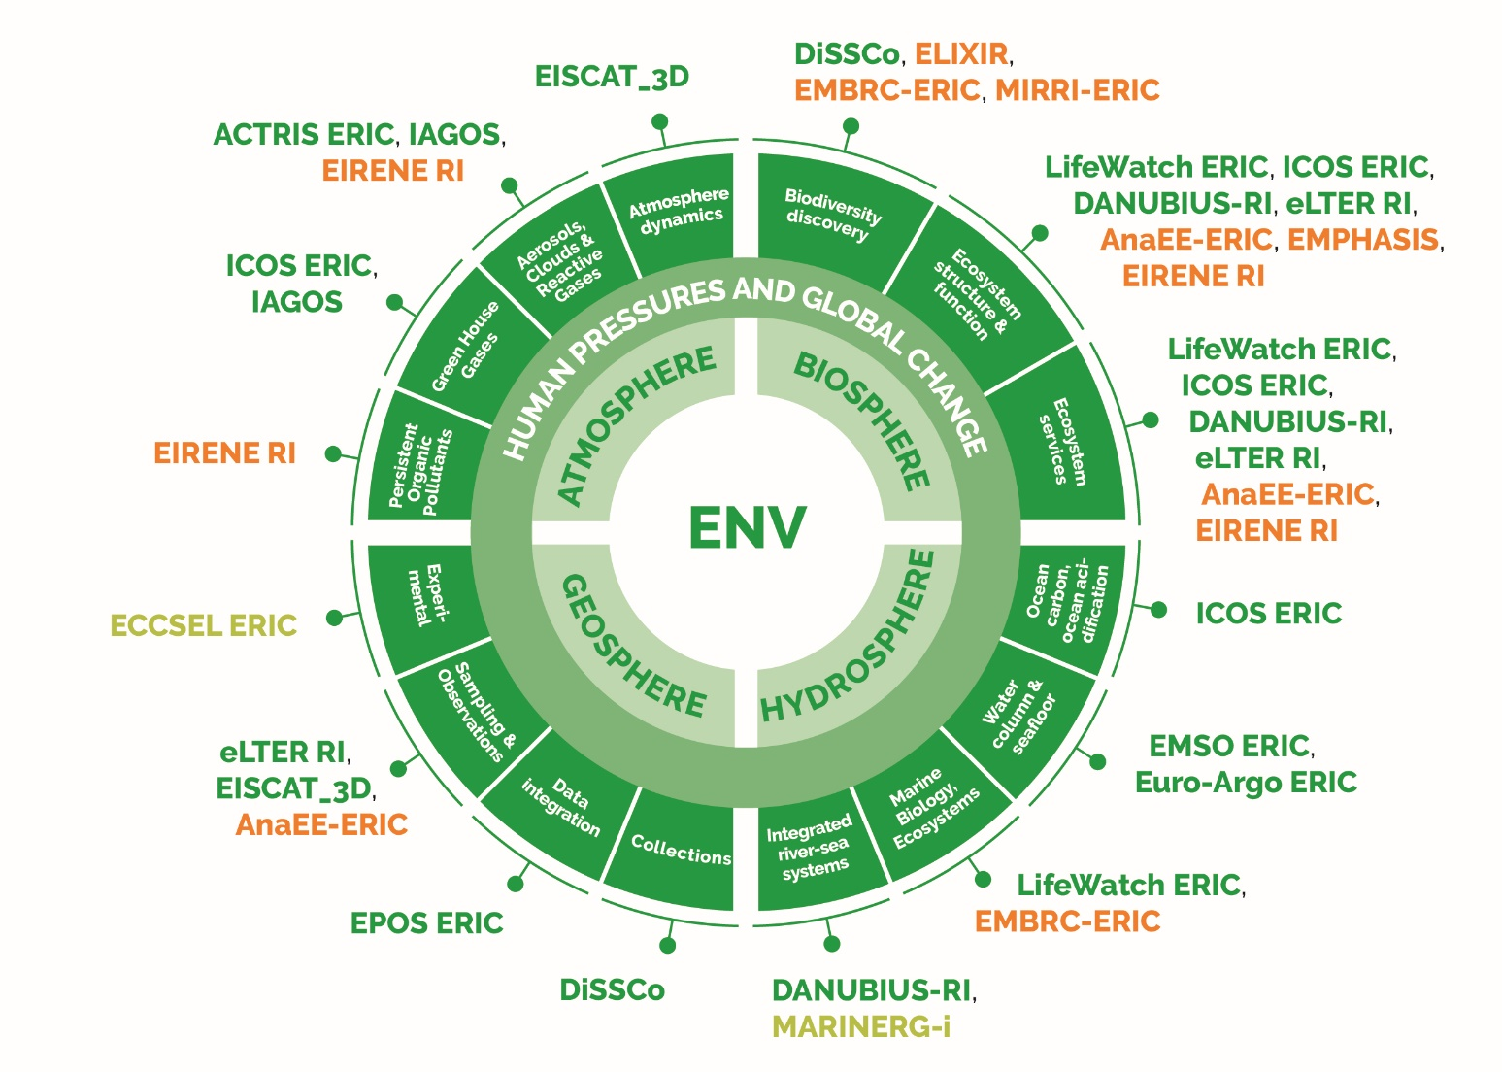
Section 1 ENV
ENV RIs are at the core of a multi-disciplinary research strategy aimed at developing a seamless holistic understanding of the Earth as a system.
They provide the foundation for advancing scientific knowledge on natural processes while developing new scientific and technological capabilities that can underpin broader and applied services.
Research and Policy
8 Landmarks (ACTRIS, EISCAT_3D, EMSO, EPOS, EURO-ARGO, IAGOS, ICOS, LifeWatch) and 3 Projects (DANUBIUS-RI, DiSSCo, eLTER RI)
Conference Research Infrastructures | 4-5 June 2024, Brussels

Slide 9
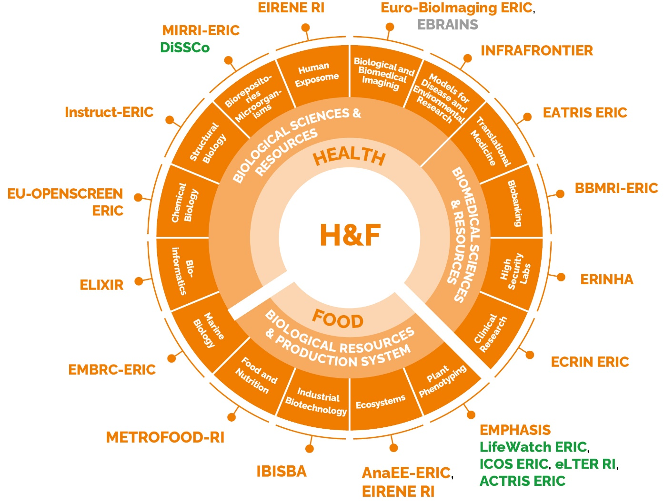
Section 1 H&F
Global challenges in the H&F domain where RIs play a major role:
the rising burden of common complex diseases;
pandemics;
livestock epidemics;
the affordability of the health care systems;
the resilience and sustainability of the entire agro-food value chain;
food and nutrition security and safety, especially in light of shocks.
12 Landmarks (ANAEE, BBMRI, EATRIS, ECRIN, ELIXIR, EMBRC, ERINHA, EU-OPENSCREEN, Euro-BioImaging, INFRAFRONTIER, INSTRUCT, MIRRI) and 4 Projects (EIRENE, EMPHASIS, EU-IBISBA, METROFOOD)
Conference Research Infrastructures | 4-5 June 2024, Brussels

Slide 10
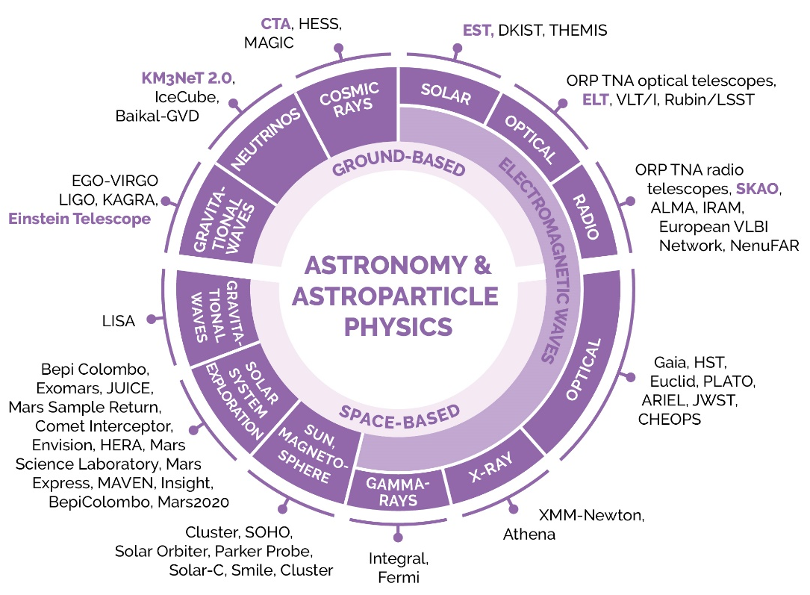
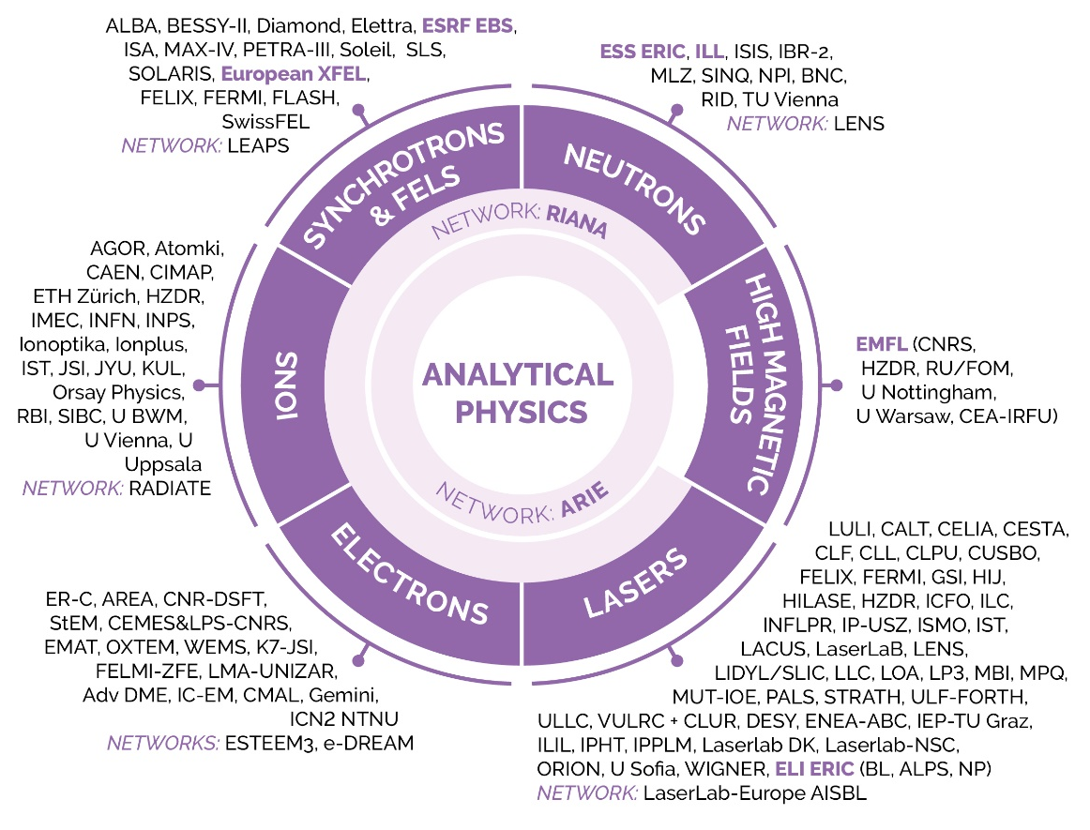
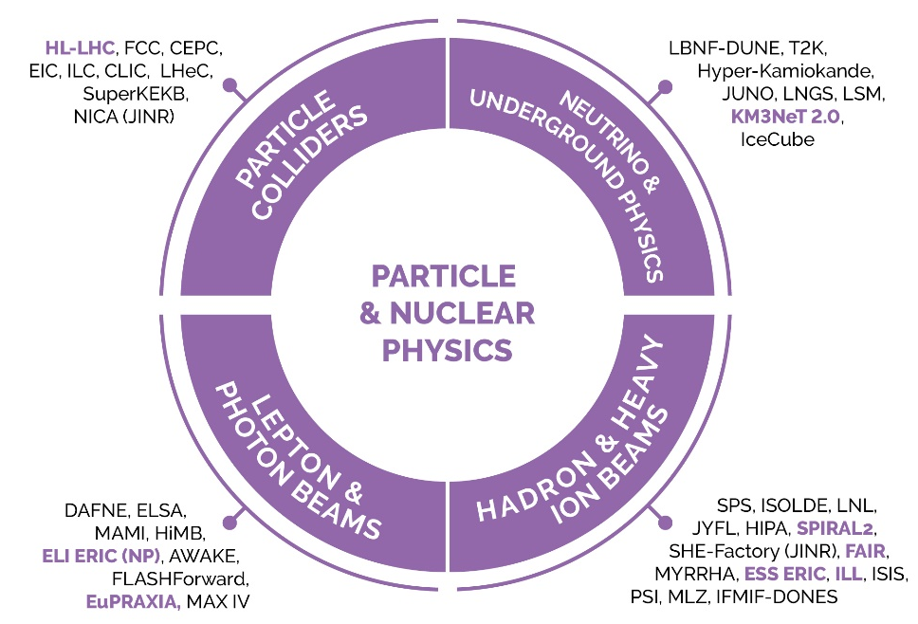
Section 1 PSE
In the PSE domain, Europe is presently at the forefront of research with world-leading Research Infrastructures.
Europe needs to secure adequate and sustainable funding for the proper operation, maintenance and development of Research Infrastructures.
12 Landmarks (CTA, ELI, ELT, EMFL, ESRF, ESS, Eu XFEL, FAIR, HL-LHC, ILL, SKAO, SPIRAL2) and 4 Projects (EST, ET, EuPRAXIA, KM3Net 2.0)
Conference Research Infrastructures | 4-5 June 2024, Brussels

Slide 11
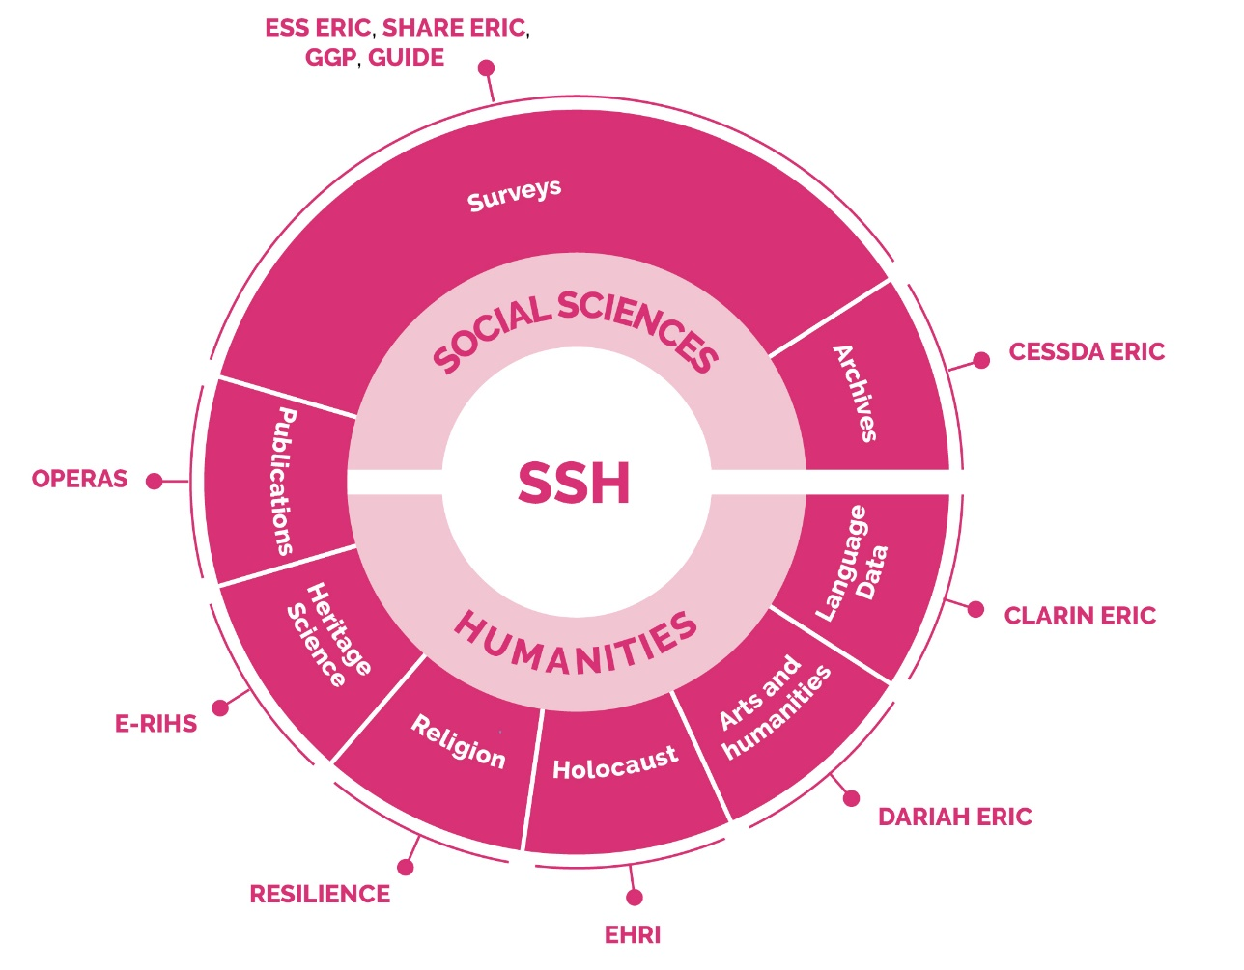
Section 1 SSH
The SSH RIs cover a wide range of academic disciplines, which help us to understand ourselves, others, and the human societies around us.
RIs in the SSH domain are evolving in a fast-changing context, where the impact of technology has major effects.
Level of funding is critical
new technological requirements imposed by very large data and models
access to high performance computing
5 Landmarks (CESSDA, CLARIN, DARIAH, ESS ERIC, SHARE) and 6 Projects (E-RIHS, EHRI, GGP, GUIDE, OPERAS, RESILIENCE)
Conference Research Infrastructures | 4-5 June 2024, Brussels

Slide 12
Section 2
The RIs landscape is evolving rapidly, influenced by a confluence of trends in scientific and technological advances, funding mechanisms, collaborative approaches, governance and human resources, and ecosystem integration.
AI revolution: transforming research across domains
Digitalisation: the new pulse of Ris
Aligning EU, national, and regional funding: the challenge of coordination
Balancing services for basic and applied research: distribution of resources
Fostering collaborative service models: interdisciplinary and cross-domain challenges
Sustainability of long-term funding: ensuring continuity
Conference Research Infrastructures | 4-5 June 2024, Brussels

Slide 13
Concluding remarks
The ESFRI RIs Landscape Analysis 2024 reflects a dynamic and responsive approach to the needs of the European research ecosystem.
This dynamic evolution needs strategic alignment, interoperability, openness, digital transformation adaptability, engagement with societal challenges, and support for cross-domain research.
ESFRI will actively follow this dynamic to guide the development of research infrastructures and contribute to the European competitiveness in the global scientific landscape.
Conference Research Infrastructures | 4-5 June 2024, Brussels

Slide 14
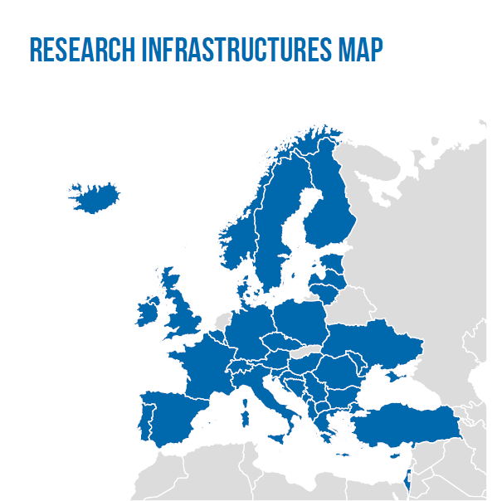
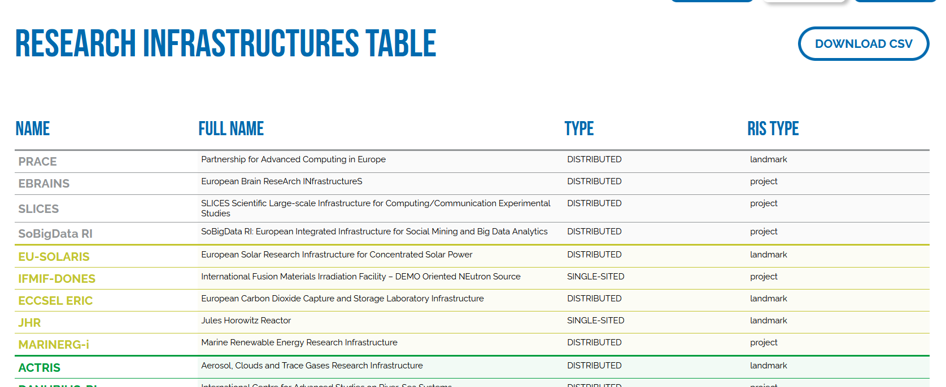

Slide 15
Thank you!
https://landscape2024.esfri.eu/
https://ri-portfolio.esfri.eu/
Conference Research Infrastructures | 4-5 June 2024, Brussels

